Slide 1
Web3 full stack design tutorial
01 - Course introduction
伍成和 ChengHe Wu
www.deCensorMedia.org
wuchenghe@vk.com
https://github.com/brianwchh

Slide 2
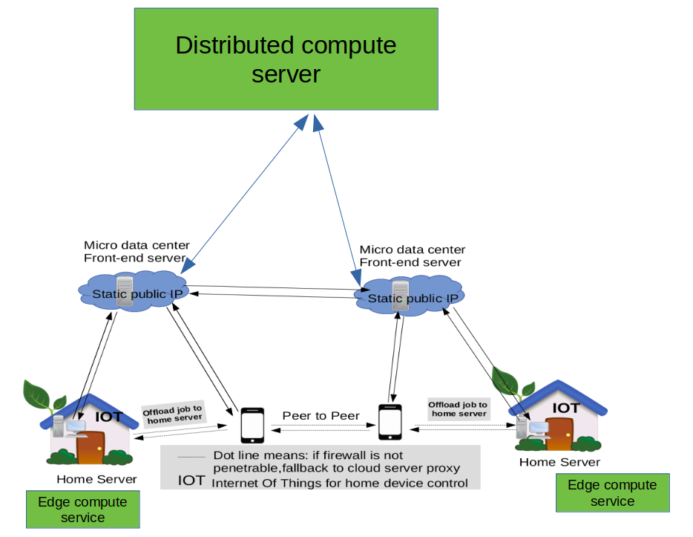
Course plan and purpose
Build a P2P website from scratch, learning by coding real project
Learn frontend(SPA-frontend rendering,backend rendering)
Learn backend using goLang
Try webassembly together

Slide 3
Course plan and purpose 2
After this course you will
learn Javascript, Golang and know the Pros & Cons of difference of other languages.
be able to build web3 website as illustrated right,a true decentralized website at your user’s own control
Try to build a new version of smart contract with go for crowdfunding incubator??? if time allowed.

Slide 4
A little about me
CV : http://www.decensormedia.org/mycv
Github : https://github.com/brianwchh

Slide 5
web languages and opportunities,a big picture 1
There are still a lot of opportunities in web world,learning a web design language is not just getting a better paycheck but more importantly creating new opportunities.
We should know language to its essence but should not be its slaver
For instance,some people think javascript will be an eternal language for frontend. But once more and more users realize javascript have unlimited access to local device which brings potential threat,I believe more and more user will disable javascript,it is just a matter of time to educate our customers to realize this danger, changing is happening gradually!
We start with javascript for web design,mostly because we have to,for now it dominates the market,but industry has tried many ways to fix this buggy language,for instance,typescript tries to perfect javascript, because it does not give a type error when we mistakenly pass wrong data to a function,which gives difficulty for debugging ,while flutter from google tries to replace javascript.

Slide 6
web languages and opportunities,a big picture 2
Nowadays industry come up with SPA(single page application) for frontend design,which I will cover in following slices! It use javascript to render webpage in the device end (desktop,mobile,tablet…), to be frank, when you visit a website using such technology,do you trust its javascript code running on your browser? Do you know what it is really doing beside just rendering the web page? Now recent years, webassembly language is invented, it is targeted for safety,portable,and faster,and will surely bring some changes in the web industry
As user we are really brave to use centralized free social media and sent a lot of private data to their data center, because we don’t know a lot of things! It is very much like we are having a confidential business meeting in someone’s room under his nose! If customers are smart they should realize this long before!
When we learn a new language we should know why it is invented? What problem they are trying to solve? So we are not get lost among so many web languages and be a slaver to it

Slide 7
web languages and opportunities,a big picture 3
Different rendering techniques for web
Frameworks: wordpress...
frontend
Cloud server
html+css+javascript
Backend
Cloud server
Database related business
Cloud server
Server end rendering
html+css(some js)
webpage
Frameworks: angular,vue,react
Frameworks: nodejs(express),python(django,….),PHP(….),GoLang(….)
PC
Version 1
PC/mobile/tablet
Device end rendering
Version 2
Single page application(SPA)
frontend
Cloud server
html+css+javascript
server end rendering
Backend
Cloud server
Database related business
PC/mobile/tablet
Version 3

Slide 8
web languages and opportunities,a big picture 3
Go vs C/C++
Go vs javascript,python
Applications: C/C++/GO
OS : linux in C
Javascript/python applicatons
Driver : C
Virtual machine/engine in C++
PC/ARM hardware
OS : linux in C
Language compilation flow
Driver : C
PC/ARM hardware
C/C++/GO
Go run natively on OS(fast) ,static language
js/python on virtual machine(slow)
All have package management,easy to recreate environment on another device
Go is better for algorithm applications
Assembly
Binary machine code

Slide 9
Webassembly & distributed cloud computing & microservice

Slide 10
Thank you
伍成和 ChengHe Wu
www.deCensorMedia.org
wuchenghe@vk.com
https://github.com/brianwchh

